Slide 1

ICHRA:
The Recession-Proof Benefit
February 22, 2023
Presented by:
Kyle Estep
Take Command

Slide 2
Today’s Agenda & Learning Objectives
ICHRA & Take Command: A Short Overview
Recent Trends & Insights
Advanced ICHRA: Navigating Inflation & Uncertain Economy
Client Case Studies

Slide 3
ICHRA & Take Command
A Short Overview

Slide 4
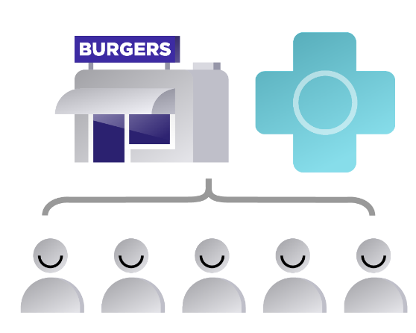

What is ICHRA? A new way to offer health insurance
An “Individual Coverage Health Reimbursement Arrangement” enables employers to reimburse employees tax-free for health insurance premiums and medical expenses.
Group Plan Model
ICHRA Model
Unlike group insurance, ICHRA provides employees the freedom of choice

Slide 5
ICHRA reimagines how we think benefits
Employers
Employees
Control: Set your budget & cap spend
Savings: Keep unclaimed reimbursements
Risk Removal: No more carrier renewals
Participation: No minimum requirements
Choice: Pick the plan that meets their needs
Flexibility: Secure the right level of coverage
Control: Decide health benefit contribution
Peace of mind: Will keep their health plan in the event of recession-induced layoffs
Predictable and controllable costs give companies steady footing in the face of a recession.
Personalized, competitive benefits help with recruitment and retention.

Slide 6
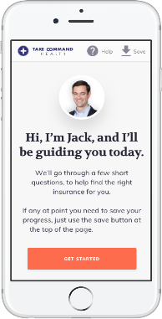









Individual Market | Comprehensive Coverage & Choice
All ACA-compliant plans include:
Free preventive care
Coverage for Essential Health Benefits
Coverage for pre-existing conditions
No medical underwriting (premiums vary by age)
Some plans include extra perks:
Free and unlimited telemedicine
Free generic drugs
Wellness benefits
Dental & vision
For employees 65+ years old…all Medicare options will be reimbursed
Health insurance companies and plan options vary by geography

Slide 7




Take Command Facts
National footprint of clients in all 50 states
5,000+ active employer clients
Headquartered in Dallas, TX with office in Austin, TX
Team of 100+ ICHRA nerds
Backed by world-class investors

Slide 8
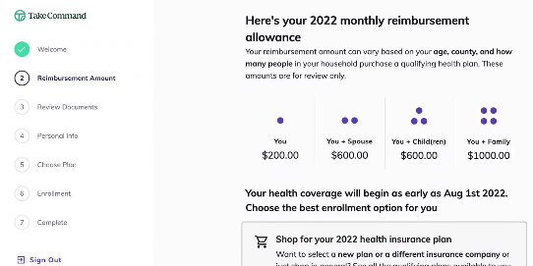
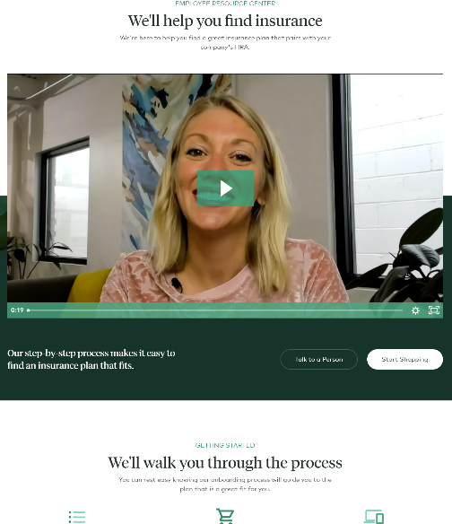

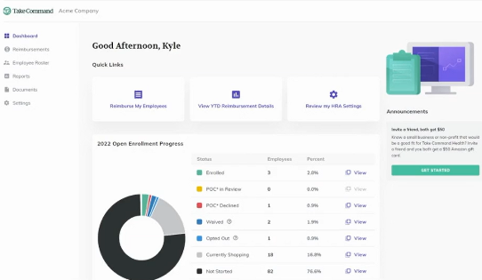











Administration Tools
Enrollment Support
Modern Payment Solution
Holding Account
Employee portal and Employer admin portal
Employee 1-on-1 meetings w/ Enrollment Specialists
“Easy Enroll” plans that we submit directly
Submitted with the application
Secure processing
Reserve balance for predictive funding
By providing all three of these together, we are equipped to best support your clients and their employees with a seamless ICHRA experience!

Slide 9
ICHRA
Recent Trends & Insights

Slide 10

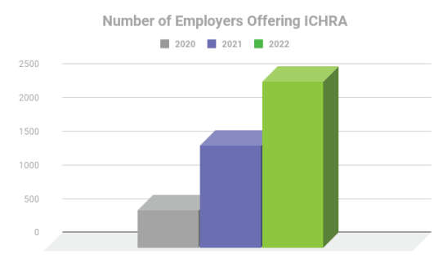
HRA Council Data
ICHRA adoption by U.S. employers has more than tripled from 2020 to 2022
The HRA Council is an industry coalition focused on education & awareness of HRAs.
Visit www.HRACouncil.org to learn more
Source: Link to Report https://hracouncil.wildapricot.org/resources/Documents/2022_HRAC_Data_FullReport_Final.pdf

Slide 11
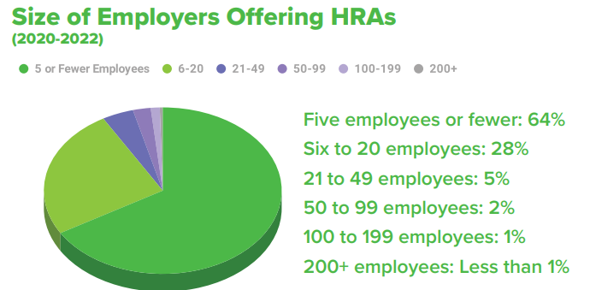
HRA Council Data
More than 90% of employers in survey had 20 or fewer employees.
Council Members report that up to 85% of their small employer clients are new to offering health benefits.
The HRA Council is an industry coalition focused on education & awareness of HRAs.
Visit www.HRACouncil.org to learn more
Source: Link to Report https://hracouncil.wildapricot.org/resources/Documents/2022_HRAC_Data_FullReport_Final.pdf

Slide 12
We see ICHRA adoption in 3 primary market segments
Mid-Market Employers:
3M firms; 45M employees
Employers required to provide insurance, but not large enough to effectively self-insure
Employee Income
$$$
$
Small Employers:
2M firms; 6M employees
Small employers new to benefits, looking for a flexible solution
ICHRA Enterprise Target:
Segments of enterprise companies that need more flexibility
Small Groups (Community Rated)
Mid-Market
(Employer Rated)
~1,000
Enterprise
(Self-Insured)
Employer Size
50

Slide 13
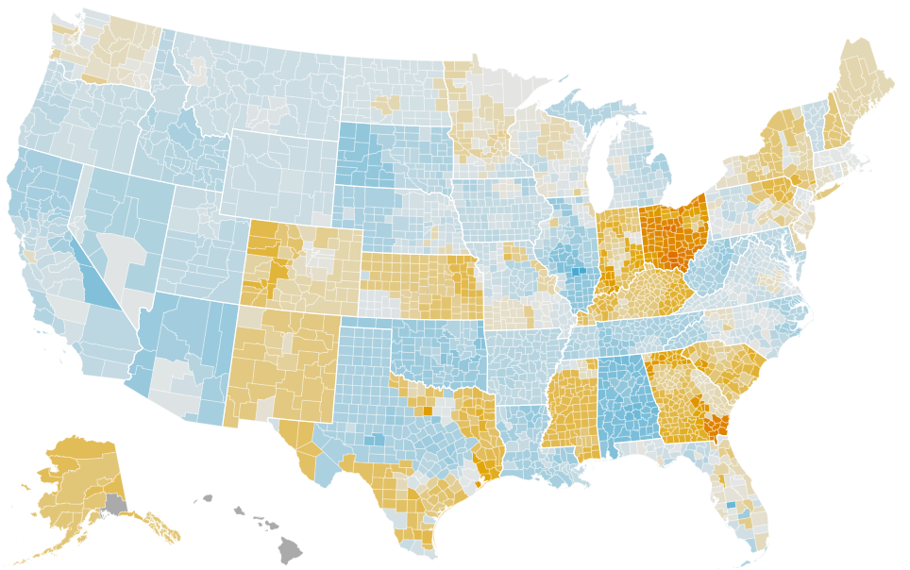
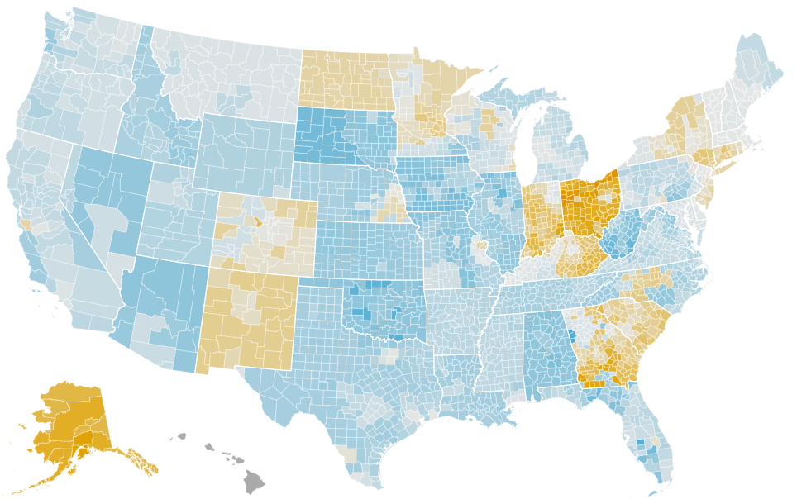
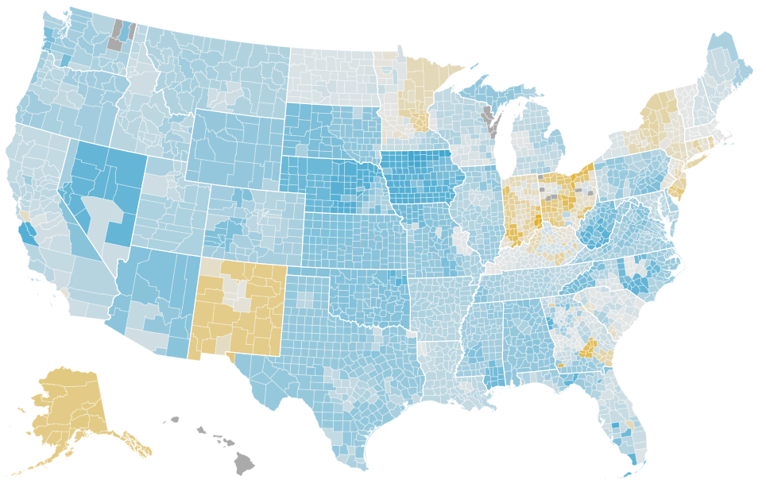
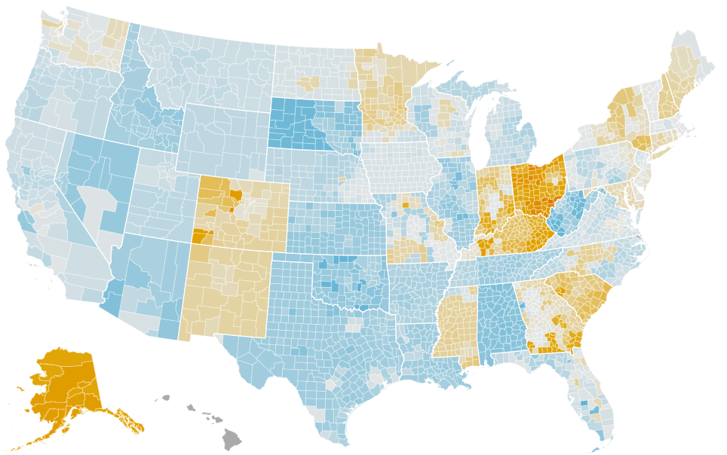

Market Trends accelerating the ICHRA value proposition
Individual vs. Group Costs
Orange =
Individual market is cheaper
2019
2020
2021
2022
Notes:
Adoption is nationwide but some states having quicker pickup than others

Slide 14
The biggest hurdles to a smooth ICHRA experience remain carrier logistics and payments infrastructure
Individual Market Hurdles
Payment Infrastructure
“My insurance cards didn’t show up.”
“Why is my coverage start date wrong?”
“I called the carrier, and they don’t see me in their database…”
“How do I know if my coverage is active?”
Holding Account
80%+
of support request to Take Command are related to individual insurance issues.

Slide 15
Advanced ICHRA
Recent How to navigate inflation, an uncertain economy, and tight labor market with your benefits strategy

Slide 16
“Inflation is our most pressing economic challenge…”
- President Biden, June 2022
Notes:
The current U.S. inflation rate is 6.5%, down from 7.1% in November, according to the latest report from the U.S. Bureau of Labor Statistics.
In June 2022, inflation hit a 40-year high of 9.1%. The next report will come out next month.

Slide 17
“CEOs name recession as their top concern globally. Inflation is their second concern.”
- 2023 C-Suite Outlook Survey
Notes:
This survey was conducted between mid-November and mid-December 2022, with 1,131 C-suite executives, including 670 CEOs across the globe, responding. Inflation and pandemic were top of mind last year.

Slide 18
“Recruitment and retention are named as top internal challenges for CEOs globally.”
- 2023 C-Suite Outlook Survey
Notes:
Inflation, recession and recruitment and retention are all things that ICHRA can help your client solve for

Slide 19

Let’s talk about ICHRA and inflation
Hypothetical:
So, if your client gets a 15% renewal…
Is that GOOD?
Is that BAD?

Slide 20
Let’s start by breaking down the main drivers behind your clients’ renewal rates:
Your Client’s Renewal = Health Risk + Inflation
Health Risk is specific to your client
Inflation is based on your client’s location and cost of healthcare in that area

Slide 21
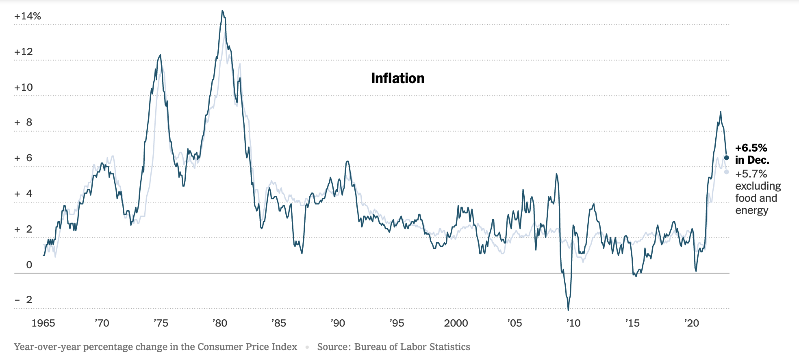
Broader inflation in the economy played a part in increased renewals for 2023. What about next year?
Notes:
Note: Inflation rate went down at end of year

Slide 22

But how much is inflation impacting insurance rates? Here’s what we learned during open enrollment.
Rate Increase Examples 2023
Other factors impact rates too including 0.5-2% for tax credit uncertainty

Slide 23
Back to our hypothetical: So, if your client gets a 15% renewal…
Is that GOOD?
Is that BAD?
Let’s look at the underlying factors in your client’s state.
In DC, insurance rates are up 15-20% over last year, so a 15% renewal rate means your client is actually beating market inflation
In GA, insurance rates are up 6-12%, so a 15% renewal rate means your client is actually losing the inflation battle or has higher risk

Slide 24
Back to our formula, let’s look at the Health Risk side
Your Client’s Renewal = Health Risk + Inflation
Health Risk is specific to your client
Inflation is based on your client’s location and cost of healthcare in that area

Slide 25
Your client size and the solution you recommend will determine their sensitivity to Health Risk.
Health Risk Sensitivity
No Sensitivity
High Sensitivity
 |  | Group Plans (Defined Benefit) |  |  |  | Reimbursement Plans (Defined Contribution)
 | Insurance Solutions | Community Rated | Fully Insured | Level-Funded | Self-Insured | ICHRA
Client Size | “Small” (<50 Employees)
 | “Mid-Market” (50-500 Employees) | n/a
 | “Enterprise” (500+ Employees) | n/a
ICHRA is an effective Health Risk removal strategy for all client sizes

Slide 26

The danger of allowing health risk to compound
Increases your client’s exposure to inflation
Will only get worse with time
Health Insurance is now the 2nd largest monthly expense for most small to medium sized business
Potential danger in locking in an inflated cost of risk ahead of a recession
If your client has had constant increases (even mild ones), it’s worth seeing if resetting their Health Risk could dramatically reduce costs

Slide 27

From a Health Risk perspective: What makes the individual market inflation resistant?
In Increased competition
Networks designed to control costs
Subsidized by the government (not your client)
A larger risk pool—17M+ instead of your client size

Slide 28
ICHRA in a potential recession: how does it help?
Predictable costs
Easy to scale up or down
Designed to optimize benefits spend
Employees keep their health plan if layoffs are necessary
Easy to pick up post-layoffs (if needed)
Only pay for what your employees use (and not any more)

Slide 29
ICHRA with recruitment & retention: how does it help?
Competitive benefits
Emphasis on employee choice and personalization
Accommodate benefits for remote employees or multi-state footprint

Slide 30
Client Discussions
How to best introduce the concept to your client

Slide 31
Your client may not fully understand recession, inflation and health risk, but they may say the following…
Employers
Employees
“Another big renewal?!... How can we get off this treadmill?”
“We are really sick of the uncertainty…”
“Will my employees have health coverage if we have to do layoffs?”
“We’re growing so fast and need a benefit solution that scales with us”
“Can we just give some earmarked $$ to the employees?”
“I don’t participate because I don’t like either of the two options I’m given.”
“I just want healthcare that I can afford and not additional programs and perks!”
“Every time we switch carriers, I’m forced to switch doctors and providers!”
“As a remote employee, this hospital network doesn’t work for me…”
“What will I do if I’m let go and lose my health coverage?”
A common CFO refrain
Notes:
Risk management burden
Never-ending steep renewals
HR administration capacity
Participation requirements

Slide 32
Case Study: Pennsylvania Tech Co.
Tech Co. Situation
Projected Renewal
Location | Pennsylvania + Remote
Industry | Technology
Employees | 260 FTE; 185 Participating
Health Benefit | Fully Insured, Group Plan
ER Issues | Escalating cost, Rising complexity managing multiple programs, Claims uncertainty
EE Issues | Lack of optionality, remote employee network issues
 | 2022 | 2023
Fully Insured Cost Estimate
$1.6M
>$2.0M
$1.49M + $0.15M HRA
Projected 30% Increase
30% renewal indicated a Health Risk problem

Slide 33
Case Study: Pennsylvania Tech Co. switch to ICHRA
Tech Co. Situation
Projected Renewal
Location | Pennsylvania + Remote
Industry | Technology
Employees | 260 FTE; 185 Participating
Health Benefit | Fully Insured, Group Plan Full ICHRA Replacement
ER Issues | Escalating cost, Rising complexity managing multiple programs, Claims uncertainty
EE Issues | Lack of optionality, remote employee network issues
 | 2022 | 2023
Fully Insured Cost Estimate
ICHRA Program with Take Command
$1.6M
>$2.0M
$1.49M + $0.15M HRA
Projected 30% Increase
You set your budget
and can dial the benefit up or down as you see fit!
$1.6M
+ No Exposure To Claims!
$400K projected savings in Year 1 alone!

Slide 34
Risk Management Case Studies
Mid-Sized Communications Company
Large Healthcare Services Organization
Situation
Situation
~100 eligible employees in Midwest
Facing +20% renewal on fully-insured plan
Third year in a row of high-rate increases
National footprint of ~3,500 eligible employees
Self-funded health plan creating headaches
On-going growth via acquisition
Solution
Solution
Full ICHRA replacement
Projected savings of ~$150,000 / year
Avoided locking in an inflated cost of risk ahead of potential recession
ICHRA replacement in select states (~1,000 EEs)
Projected savings of ~$1.4M / year
Avoided locking in an inflated cost of risk ahead of potential recession
Notes:
Risk management burden
Never-ending steep renewals
HR administration capacity
Participation requirements

Slide 35
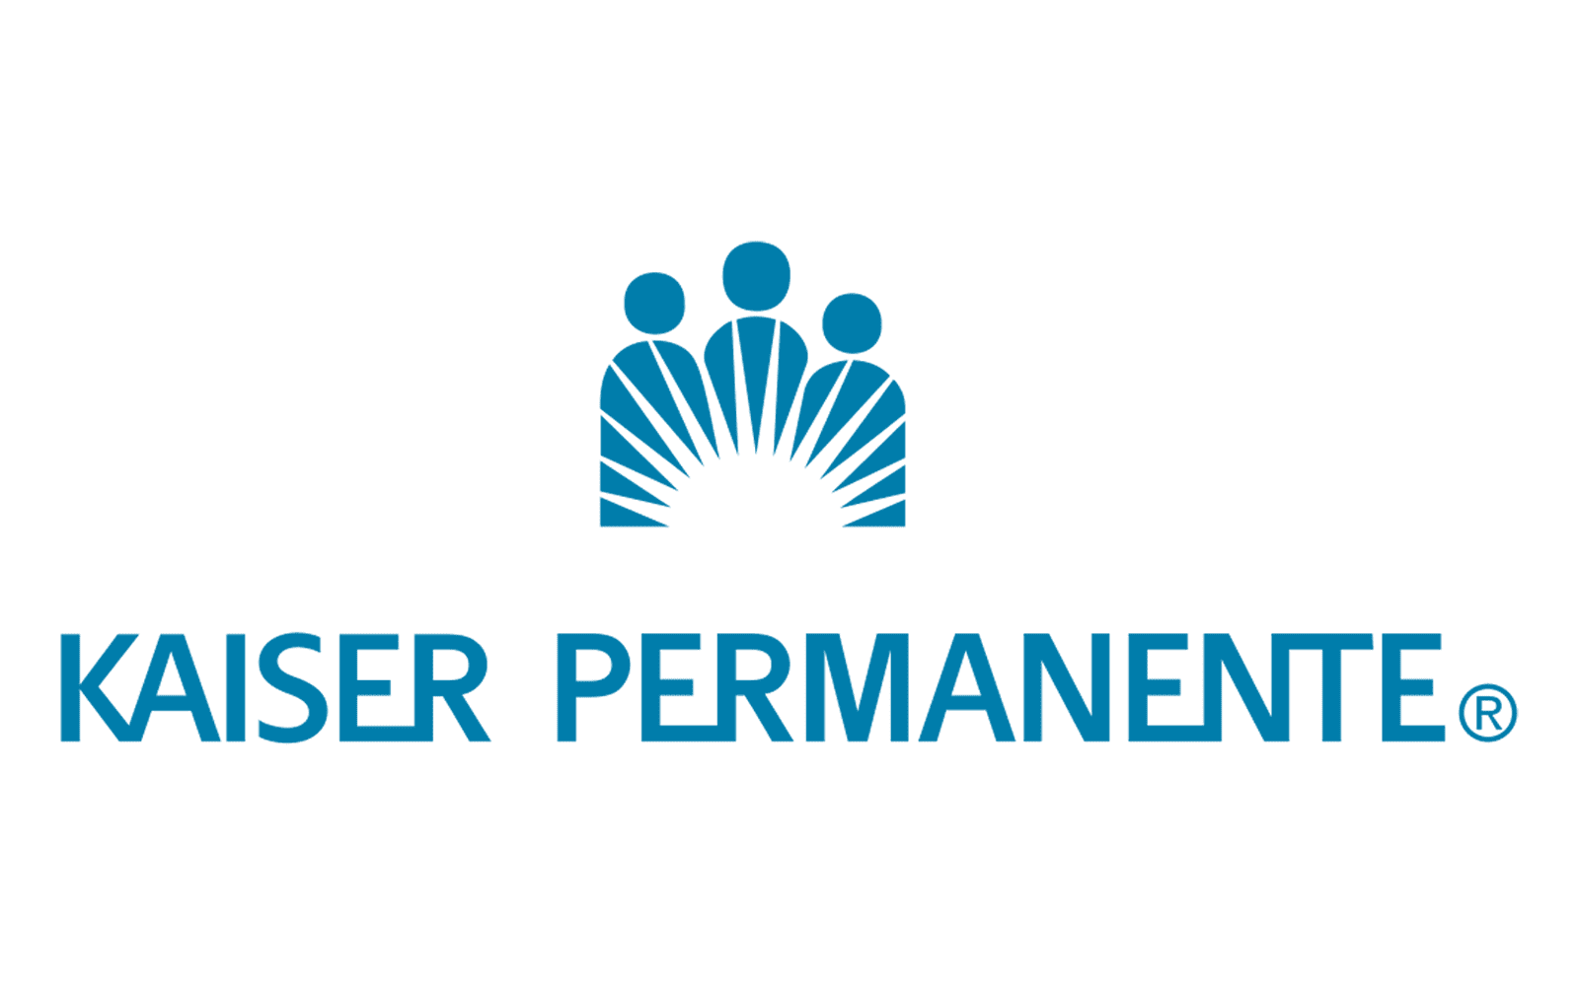

Choice and Flexibility Case Studies
The Kaiser Permanente Challenge
VC-Backed Healthcare Startup
Situation
Situation
Offering Kaiser to groups is always tricky…
Employees love or hate the integrated system
Common situation in CA, CO, GA, MD, etc.
Headquartered in NY, but workforce spread wide
Started with ~5 EEs but quickly growing
NY Small Group not a good fit & PEOs $$$
Solution
Solution
ICHRA!!
Employees have carrier choice (including KP!) and can keep their plans in the case of layoffs
Generous ICHRA for premiums & medical expenses
Fast setup speed critical to value proposition
Notes:
Risk management burden
Never-ending steep renewals
HR administration capacity
Participation requirements

Slide 36
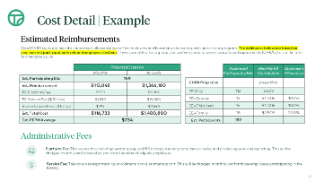
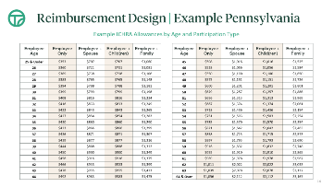

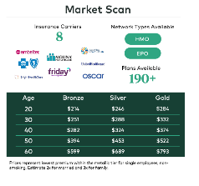
Introducing ICHRA to your clients
Introduce the Concept
“Let’s see what would happen if we took your current spend, and instead of investing into a group plan, we gave it to your employees as a tax-free allowance….could they buy something equal or better?”
Set the Target Budget
Design an ICHRA program that dials in your target spend, optimizes your offer to employees, and satisfies all regulatory requirements.
Review Purchasing Power
Explore individual market in key employee geographies, consider purchasing power of ICHRA program design compared to current group plan.

Slide 37
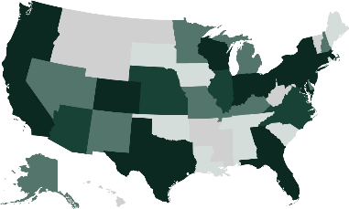










Change is hard, but that’s where we come in!
Take Command Experience
Trusted By
With the industry’s first end-to-end ICHRA solution, we are proud to work with 90% of the top 100 employee benefit brokerage firms.
>5K
Employers across all 50 states
93%
Industry best renewal rate
210%
Rise in large employer enrollments

Slide 38
Questions

Slide 39
Appendix

Slide 40
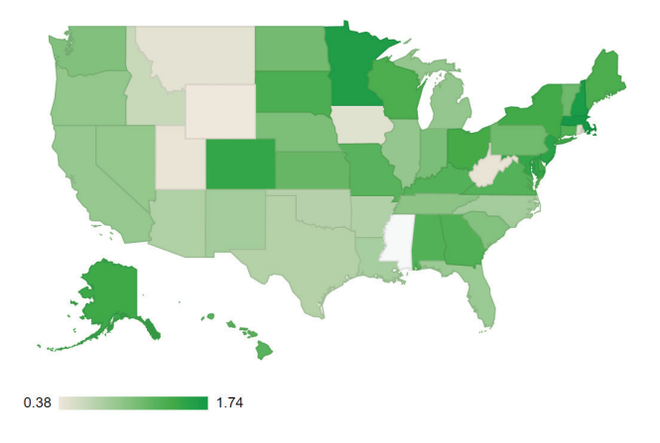
HRA Council Data
Between 2020 and 2022, adoption increased across the nation
Some regions and states saw faster growth than others.
The HRA Council is an industry coalition focused on education & awareness of HRAs.
Visit www.HRACouncil.org to learn more
Source: Link to Report https://hracouncil.wildapricot.org/resources/Documents/2022_HRAC_Data_FullReport_Final.pdf

Slide 41
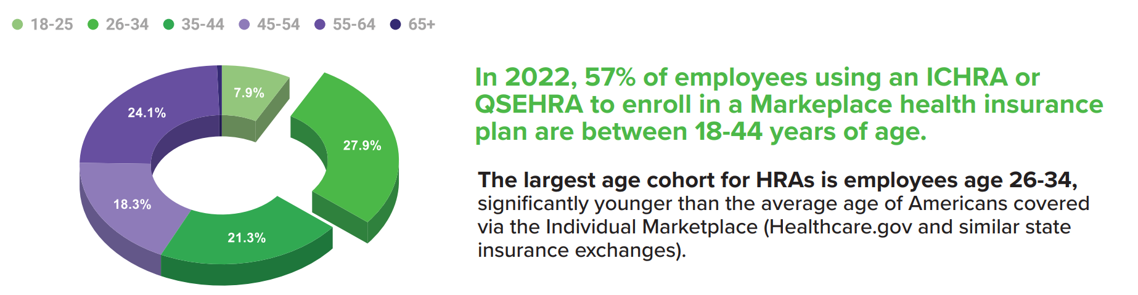
HRA Council Data
The HRA Council is an industry coalition focused on education & awareness of HRAs.
Visit www.HRACouncil.org to learn more
Source: Link to Report https://hracouncil.wildapricot.org/resources/Documents/2022_HRAC_Data_FullReport_Final.pdf

Slide 42



We’re also committed to creating a modern, ICHRA-specific payment solution (ie, “Venmo” for ICHRA)
 | Old School Solutions | Traditional Banking Solutions |  | ICHRA Specific Solutions
 | Payroll Reimbursements | Credit Cards | Bank Accounts | Virtual Accounts
Description | Employees pay with personal accounts and are reimbursed through payroll | Credit cards employees use to purchase coverage | Pre-funded bank accounts or loans employees use to purchase coverage | Tailored “virtual” accounts provided directly to insurance companies
Employee Burden | High | Med | High | None
Admin Burden | Med | Med | Med | Low
Employer Transactions | One for each employee each month | One a month | One a month | One a month
Insurance Company Acceptance | 100% | Less than 12 carriers | 100% | 50+ carriers and growing!
Security | N/A | High | Low | High
Cost | Low | Med | High | Low
Time to Detect Non-Coverage Issues | Quarterly or Annually | Month Delay | Month Delay | Daily
Time for Initial Setup | Instant | 5-10 Days | 30-45 Days | 15-30 Days
Time for New Hire and Termination Changes | Instant | 5-10 Days | 10-20 Days | Instant

